Slide 1
Lecture 04 – Part A Knowledge Representation and Reasoning
Dr. Shazzad Hosain
Department of EECS
North South Universtiy
shazzad@northsouth.edu

Slide 2
Knowledge Representation & Reasoning
Introduction
How can we formalize our knowledge about the world so that:
We can reason about it?
We can do sound inference?
We can prove things?
We can plan actions?
We can understand and explain things?

Slide 3
Knowledge Representation & Reasoning
Introduction
Objectives of knowledge representation and reasoning are:
form representations of the world.
use a process of inference to derive new representations about the world.
use these new representations to deduce what to do.

Slide 4
Knowledge Representation & Reasoning
Introduction
Some definitions:
Knowledge base: set of sentences. Each sentence is expressed in a language called a knowledge representation language.
Sentence: a sentence represents some assertion about the world.
Inference: Process of deriving new sentences from old ones.

Slide 5
Knowledge Representation & Reasoning
Introduction
Declarative vs procedural approach:
Declarative approach is an approach to system building that consists in expressing the knowledge of the environment in the form of sentences using a representation language.
Procedural approach encodes desired behaviors directly as a program code.

Slide 6
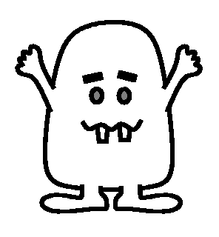
Knoweldge Representation & Reasoning
Example: Wumpus world
THE WUMPUS

Slide 7

Knoweldge Representation & Reasoning
Environment
Squares adjacent to wumpus are smelly.
Squares adjacent to pit are breezy.
Glitter if and only if gold is in the same square.
Shooting kills the wumpus if you are facing it.
Shooting uses up the only arrow.
Grabbing picks up the gold if in the same square.
Releasing drops the gold in the same square.
Goals: Get gold back to the start without entering in pit or wumpus square.
Percepts: Breeze, Glitter, Smell.
Actions: Left turn, Right turn, Forward, Grab, Release, Shoot.

Slide 8
Knoweldge Representation & Reasoning
The Wumpus world
Is the world deterministic?
Yes: outcomes are exactly specified.
Is the world fully accessible?
No: only local perception of square you are in.
Is the world static?
Yes: Wumpus and Pits do not move.
Is the world discrete?
Yes.

Slide 9
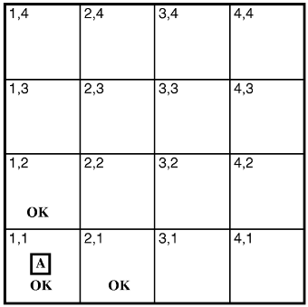
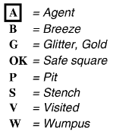
Exploring a wumpus world
Notes:
‹#›

Slide 10
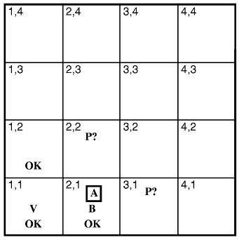
Exploring a wumpus world
Notes:
‹#›

Slide 11
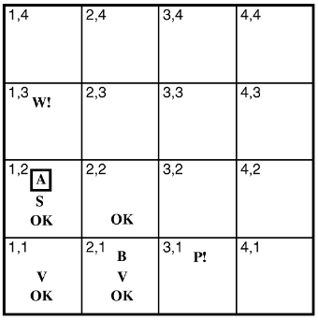
Exploring a wumpus world
If the Wumpus were
here, stench should be
here. Therefore it is
here.
Since, there is no breeze
here, the pit must be
there
Notes:
‹#›

Slide 12
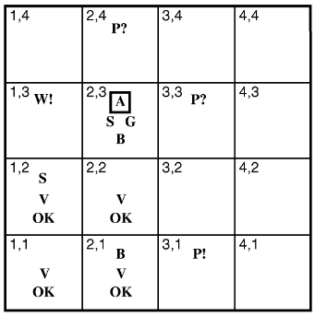
Exploring a wumpus world
Notes:
‹#›

Slide 13
Knoweldge Representation & Reasoning
Fundamental property of logical reasoning:
In each case where the a conclusion is drawn from the available information, that conclusion is guaranteed to be correct if the available information is correct.

Slide 14
Knoweldge Representation & Reasoning
Fundamental concepts of logical representation

Slide 15
Knoweldge Representation & Reasoning
Fundamental concepts of logical representation
Logics are formal languages for representing information such that conclusions can be drawn.
Each sentence is defined by a syntax and a semantic.
Syntax defines the sentences in the language. It specifies well formed sentences.
Semantics define the ``meaning'' of sentences;
i.e., in logic it defines the truth of a sentence in a possible world.

Slide 16
Knoweldge Representation & Reasoning
Fundamental concepts of logical representation
For example, the language of arithmetic
x + 2 ≥ y is a sentence.
x + y > is not a sentence.
x + 2 ≥ y is true iff the number x+2 is not less than the number y.
x + 2 ≥ y is true in a world where x = 7, y =1.
x + 2 ≥ y is false in a world where x = 0, y= 6.

Slide 17
Knoweldge Representation & Reasoning
Fundamental concepts of logical representation
Model: This word is used instead of “possible world” for sake of precision.
m is a model of a sentence α
means α is true in model m
Definition: A model is a mathematical abstraction that simply fixes the truth or falsehood of every relevant sentence.

Slide 18
Knoweldge Representation & Reasoning
Fundamental concepts of logical representation
m is a model of a sentence α
means α is true in model m
Example: x number of men and y number of women sitting at a table playing bridge.
x+ y = 4 is a sentence which is true
when the total number is four.
Model : possible assignment of numbers to the variables x and y. Each assignment fixes the truth of any sentence whose variables are x and y.
Model for x+y=4: (x, y) = {(0,4),(4,0),(3,1),(1,3),(2,2)}

Slide 19
Knoweldge Representation & Reasoning
Entailment: Logical reasoning requires the relation of logical entailment between sentences: « a sentence follows logically from another sentence ».
Mathematical notation: α╞ β
(α entails the sentenceβ)
Formal definition: α╞ β if and only if in every model in which α is true, β is also true. (truth of β is contained in the truth of α).
Fundamental concepts of logical representation

Slide 20
Entailment
Fundamental concepts of logical representation
Entail
Sentences
α
Sentences
KB
Logical
Representation
Semantics
Semantics
Follows
World
Facts
Facts
Logical reasoning should ensure that the new configurations represent aspects of the world that actually follow from the aspects that the old configurations represent.
Notes:
‹#›

Slide 21
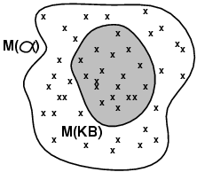
Knoweldge Representation & Reasoning
Model cheking: Enumerates all possible models to check that α is true in all models in which KB is true.
Mathematical notation: KB α
The notation says:
α is derived from KB by i
or i derives α from KB.
i is an inference algorithm.
Fundamental concepts of logical representation
i

Slide 22
Knoweldge Representation & Reasoning
Fundamental concepts of logical representation
An inference procedure can do two things:
Given KB, generate new sentence α purported to be entailed by KB.
Given KB and α, report whether or not α is entailed by KB.
Sound or truth preserving: inference algorithm that derives only entailed sentences.
Completeness: an inference algorithm is complete, if it can derive any sentence that is entailed.

Slide 23
Knoweldge Representation & Reasoning
Explaining more Soundness and completeness
Soundness: if the system proves that something is true, then it is really true. The system doesn’t derive contradictions
Completeness: if something is really true, it can be proven using the system. The system can be used to derive all the true mathematical statements one by one

